Slide 1

Programming in Java Files and I/O Streams
By
Ravi Kant Sahu
Asst. Professor
Lovely Professional University, Punjab

Slide 2
Introduction
Most real applications of Java are not text-based, console programs.
Java’s support for console I/O is limited.
Text-based console I/O is not very important to Java programming.
Java does provide strong, flexible support for I/O as it relates to files and networks.

Slide 3
Files

Slide 4
File Class
The File class provides the methods for obtaining the properties of a file/directory and for renaming and deleting a file/directory.
An absolute file name (or full name) contains a file name with its complete path and drive letter.
For example, c:\book\Welcome.java
A relative file name is in relation to the current working directory.
The complete directory path for a relative file name is omitted.
For example, Welcome.java

Slide 5
File Class
The File class is a wrapper class for the file name and its directory path.
For example, new File("c:\\book")
creates a File object for the directory c:\book,
new File("c:\\book\\test.dat")
creates a File object for the file c:\book\test.dat
File class does not contain the methods for reading and writing file contents.

Slide 6
Methods and Constructors
Constructor:
File(String path_name)
Creates a File object for the specified path name. The path name may be a directory or a file.

Slide 7
Methods of File Class
Methods:
boolean isFile()
boolean isDirectory()
boolean isHidden()
boolean exists()
boolean canRead()
boolean canWrite()
String getName()
String getPath()
String getAbsolutePath()
long lastModified()
long length()
boolean delete()
boolean renameTo(File f)
File [] listFiles()

Slide 8
Important
The lastModified() method returns the date and time when the file was last modified.
It is measured in milliseconds since the beginning of Unix time (00:00:00 GMT, January 1, 1970).
The Date class is used to display it in a readable format.
System.out.println("Last modified on " +
new java.util.Date(file.lastModified()));

Slide 9
Reading and Writing Files
In Java, all files are byte-oriented, and Java provides methods to read and write bytes from and to a file.
Java allows us to wrap a byte-oriented file stream within a character-based object.
We can use Scanner and PrintWriter class to read and write Files.

Slide 10
PrinterWriter Class
Although using System.out to write to the console is acceptable.
The recommended method of writing to the console when using Java is through a PrintWriter stream.
PrintWriter is one of the character-based classes.
Using a character-based class for console output makes it easier to internationalize your program.
PrintWriter(OutputStream outputStream, boolean flushOnNewline)

Slide 11
outputStream is an object of type OutputStream.
flushOnNewline controls whether Java flushes the output stream every time a println( )method is called.
If flushOnNewline is true, flushing automatically takes place.
If false, flushing is not automatic.
PrintWriter supports the print( ) and println( ) methods for all types including Object. Thus, we can use these methods in the same way as they have been used with System.out.
If an argument is not a simple type, the PrintWriter methods call the object’s toString( ) method and then print the result.

Slide 12
Using PrintWriter
import java.io.*;
public class PrintWriterDemo
{
public static void main(String args[])
{
PrintWriter pw = new PrintWriter(System.out, true);
pw.println(“Using PrintWriter Object");
int i = -7;
pw.println(i);
double d = 4.5e-7;
pw.println(d);
}
}

Slide 13
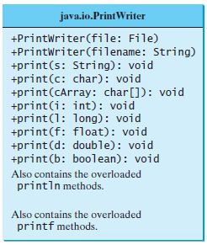
PrintWriter Methods

Slide 14
Using Scanner
The java.util.Scanner class is used to read strings and primitive values from the console.
Scanner breaks the input into tokens delimited by whitespace characters.
To read from the keyboard, we create a Scanner as follows:
Scanner s = new Scanner(System.in);
To read from a file, create a Scanner for a file, as follows:
Scanner s = new Scanner(new File(filename));

Slide 15
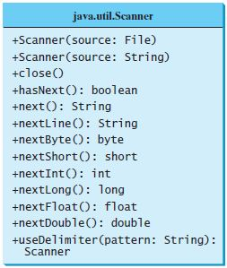
Scanner Methods

Slide 16
I/O Streams

Slide 17
Streams
Java implements streams within class hierarchies defined in the java.io package.
A stream is an ordered sequence of data.
A stream is linked to a physical device by the Java I/O system.
All streams behave in the same manner, even if the actual physical devices to which they are linked differ.
An I/O Stream represents an input source or an output destination.

Slide 18
I/O Streams
A stream can represent many different kinds of sources and destinations
– disk files, devices, other programs, a network socket, and memory arrays
Streams support many different kinds of data
– simple bytes, primitive data types, localized characters, and objects
Some streams simply pass on data; others manipulate and transform the data in useful ways.

Slide 19
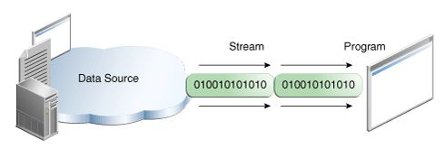
Input Stream
A program uses an input stream to read data from a source, one item at a time.
Reading information into a program.

Slide 20
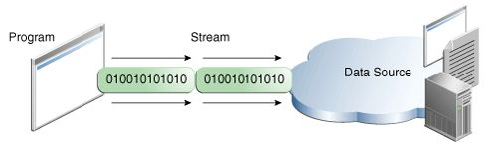
Output Stream
A program uses an output stream to write data to a destination, one item at time:
Writing information from a program.

Slide 21
Types of Streams
Java defines two different types of Streams-
Byte Streams
Character Streams
Byte streams provide a convenient means for handling input and output of bytes.
Byte streams are used, for example, when reading or writing binary data.
Character streams provide a convenient means for handling input and output of characters.
In some cases, character streams are more efficient than byte streams.

Slide 22
Byte Streams
Programs use byte streams to perform input and output of 8-bit bytes.
Byte streams are defined by using two class hierarchies.
At the top, there are two abstract classes: InputStream and OutputStream.
The abstract classes InputStream and OutputStream define several key methods that the other stream classes implement.
Two of the most important methods are read( )and write( ), which, respectively, read and write bytes of data.
Both methods are declared as abstract inside InputStream and OutputStream.

Slide 23
Closing the Streams
Closing a stream when it's no longer needed is very important.
It is so important that we have used a finally block to guarantee that both streams will be closed even if an error occurs. This practice helps avoid serious resource leaks.
When we call the close(), it clears the buffer by performing the write operation to the destination and then closes the stream.
That's why CopyBytes makes sure that each stream variable contains an object reference before invoking close.

Slide 24
Binary I/O classes

Slide 25
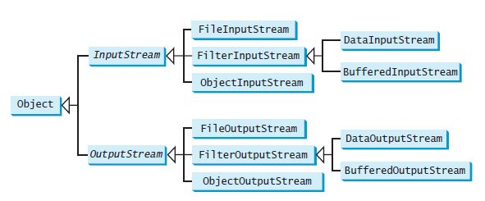
Binary Input/Output Classes

Slide 26
Byte Stream Classes
Stream Class | Meaning / Use
BufferedInputStream | Buffered input stream
BufferedOutputStream | Buffered output stream
DataInputStream | contains methods for reading the Java standard data types
DataOutputStream | contains methods for writing the Java standard data types
FileInputStream | Input stream that reads from a file
FileOutputStream | Output stream that writes to a file
InputStream | Abstract class that describes stream input
OutputStream | Abstract class that describes stream output
PrintStream | Output stream that contains print() and println( )
PipedInputStream | Input Pipe
PipedOutputStream | Output Pipe

Slide 27
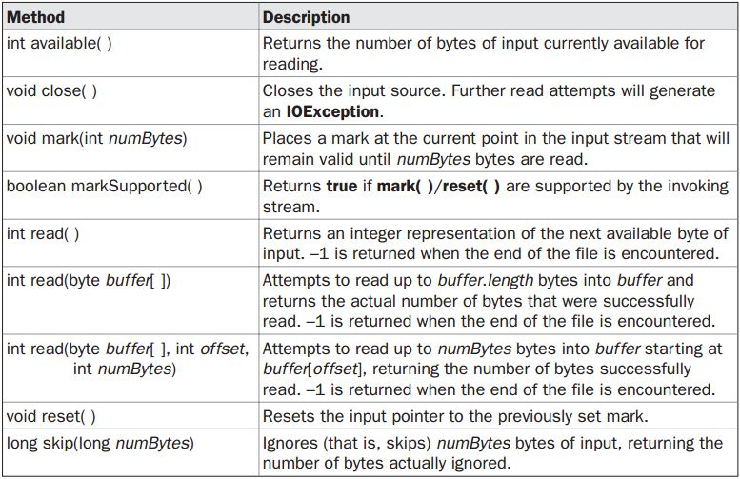
Methods defined by ‘InputStream’

Slide 28
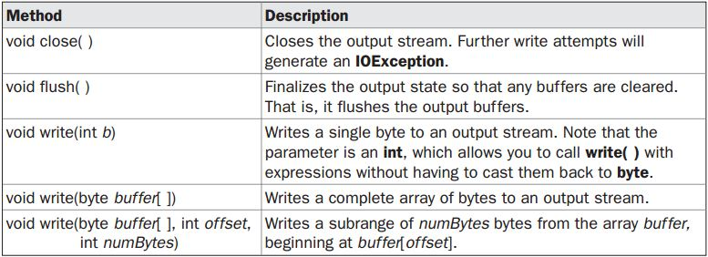
Methods defined by ‘OutputStream’

Slide 29
FileInputStream and FileOutputStream
FileInputStream and FileOutputStream are stream classes which create byte streams linked to files.
FileInputStream(String fileName) throws FileNotFoundException
FileInputStream(File f) throws FileNotFoundException
FileOutputStream(String fileName) throws FileNotFoundException
FileOutputStream(File f) throws FileNotFoundException
FileOutputStream(String fileName, boolean append) throws FileNotFoundException
FileOutputStream(File f, boolean append) throws FileNotFoundException

Slide 30
Reading and Writing Files
To read from a file, we can use read( ) that is defined with in FileInputStream.
int read( ) throws IOException
Each time read() is called, it reads a single byte from the file and returns the byte as an integer value.
To write to a file, we can use the write( )method defined by FileOutputStream.
void write(int byteval) throws IOException

Slide 31
import java.io.*;
class CopyFile {
public static void main(String args[])throws IOException{
int i; FileInputStream fin=null; FileOutputStream fout=null;
fin = new FileInputStream(args[0]);
fout = new FileOutputStream(args[1]);
try {
do { i = fin.read();
if(i != -1) fout.write(i);
} while(i != -1);
}
catch(IOException e) {
System.out.println("File Error");
}
fin.close();
fout.close();
}
}

Slide 32
Object Input/Output
ObjectInputStream/ObjectOutputStream classes can be used to read/write serializable objects.
ObjectInputStream/ObjectOutputStream enables you to perform I/O for objects in addition to primitive type values and strings.
ObjectInputStream/ObjectOutputStream contains all the functions of DataInputStream/ DataOutputStream.

Slide 33
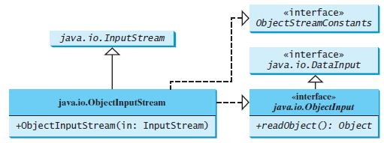
Constructor and Methods of ObjectInputStream

Slide 34
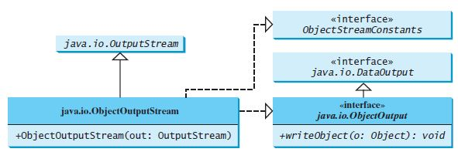
Constructor and Methods of ObjectOutputStream

Slide 35
Serialization

Slide 36
Serialization
Serialization is the process of writing the state of an object to a byte stream.
This is useful when we want to save the state of our program to a persistent storage area, such as a file.
At a later time, we may restore these objects by using the process of de-serialization.
Serialization is also needed to implement Remote Method Invocation (RMI).

Slide 37
An object to be serialized may have references to other objects, which, in turn, have references to still more objects.
If we attempt to serialize an object at the top of an object graph, all of the other referenced objects are recursively located and serialized.

Slide 38
Serializable Interface
Only an object that implements the Serializable interface can be saved and restored by the serialization facilities.
The Serializable interface defines no members.
It is simply used to indicate that a class may be serialized.
If a class is serializable, all of its subclasses are also serializable.

Slide 39
Serialization Example
class MyClass implements Serializable
{
String s;
int i;
double d;
public MyClass(String s, int i, double d) {
this.s = s;
this.i = i;
this.d = d;
}
public String toString()
{
return "s=" + s + "; i=" + i + "; d=" + d;
}
}

Slide 40
import java.io.*;
public class SerializationDemo {
public static void main(String args[]) {
try {
MyClass object1 = new MyClass("Hello", -7, 2.7e10);
System.out.println("object1: " + object1);
FileOutputStream fos = new FileOutputStream("serial.txt");
ObjectOutputStream oos = new ObjectOutputStream(fos);
oos.writeObject(object1);
oos.flush();
oos.close();
}
catch(IOException e) {
System.out.println("Exception during serialization: " + e);
System.exit(0);
}

Slide 41
// Object deserialization
try {
MyClass object2;
FileInputStream fis = new FileInputStream("serial.txt");
ObjectInputStream ois = new ObjectInputStream(fis);
object2 = (MyClass)ois.readObject();
ois.close();
System.out.println("object2: " + object2);
}
catch(Exception e) {
System.out.println("Exception during deserialization: " + e);
System.exit(0);
}
}
}

Slide 42
Exercise
Write a program which prompts the user to enter the path of the file to be read (f1) and file to be written(f2).
Append the content of the file f1 at the end of file f2.
Write a program to define a class Car having attributes name, mileage and price. Create 5 Car objects and write those objects in a file named as mycar.doc.
Write a method public void getCars(double mlg) which displays the name, price and mileage of all the cars having mileage greater than mlg.

